Slide 1
Web Design & Figma Workshop
Build Your First Landing Page from Scratch
Beginner-Friendly
3-Hour Workshop
Hands-On Learning

Slide 2
Workshop Overview
What We'll Learn Today
01
02
03
Web Design Basics
Figma Fundamentals
Build Your Page
Understand what makes landing pages effective and learn the core visual design principles that professionals use every day.
Apply everything you've learned by building a complete landing page from scratch, with guided step-by-step instruction.
Get comfortable with Figma's interface and master the essential tools you'll need to bring your design ideas to life.
Interface tour
Landing page anatomy
Define your project
Essential tools
Visual hierarchy
Wireframe to UI
Styles & assets
Real-world examples
Complete design
30-40 minutes
40-50 minutes
90-100 minutes
Workshop Style: Mixed levels welcome! Beginners follow step-by-step, advanced learners explore extra challenges.

Slide 3
01
Web Design Basics
Understanding Landing Pages & Visual Principles
Structure
Principles
Examples

Slide 4

Web Design Basics
What is a Landing Page?
Purpose
A landing page is a standalone web page designed for a single, focused objective—whether that's getting signups, showcasing a product, or introducing your portfolio.
Typical Structure
1
Hero Section
Big headline + compelling visual
2
Features/Benefits
What you offer & why it matters
3
Social Proof
Testimonials, logos, trust signals
4
Call to Action (CTA)
Clear next step for visitors
Key Insight: Each section has a job to do. Together, they guide visitors toward taking action.
5
Footer
Links, contact info, legal

Slide 5
Web Design Basics
Core Visual Design Principles
Hierarchy
Spacing & Alignment
Typography & Color
Guide the viewer's eye through your content by establishing clear visual importance.
White space isn't empty, it's breathing room that makes content easier to scan and understand.
Consistency creates professionalism. Stick to a limited set of fonts and colors throughout your design.
Example
Big Headline
Good vs Poor
Color Palette Example
Medium Subheading
✓ Consistent spacing
Small body text with details...
Primary • Accent • Secondary
✗ Random spacing
Headlines: Largest, boldest
Consistent margins
2-3 fonts maximum
Subheadings: Medium size
Elements aligned to grid
3-5 colors in palette
Body text: Smallest, readable
Equal spacing between items
Apply consistently
Remember: These principles work together. Hierarchy guides attention, spacing creates clarity, and consistency builds trust.

Slide 6
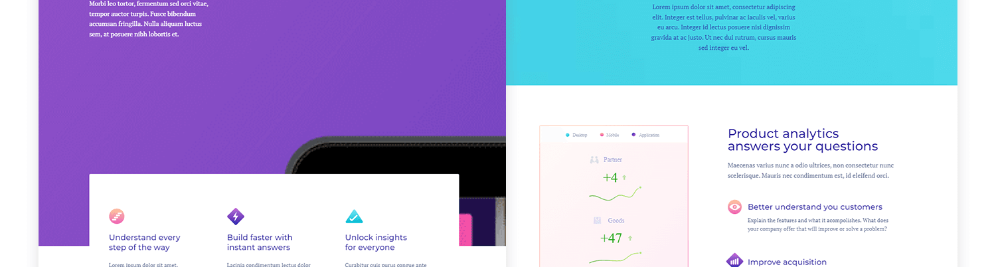
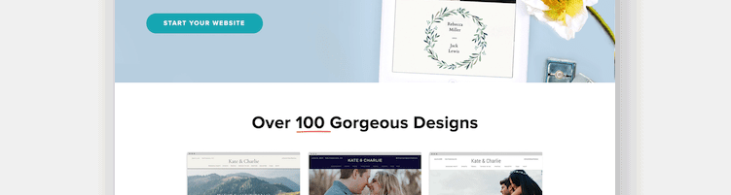
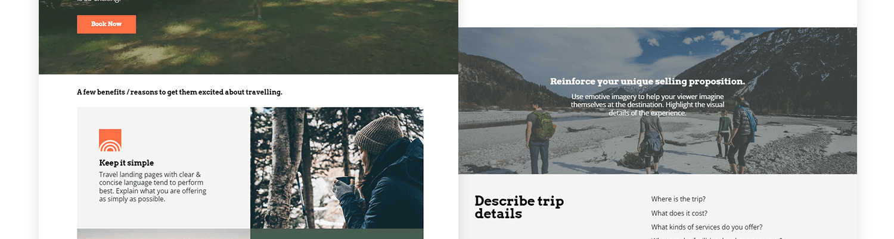
Web Design Basics
Great Landing Page Examples
Let's deconstruct what makes these designs effective
SaaS Product Page
Service Business Page
Clear hero: Value proposition above the fold
Clean layout: Plenty of white space
Visual hierarchy: Purple draws attention to key areas
Strong CTA: Teal buttons stand out
Feature icons: Easy-to-scan benefits
Social proof: "100+ designs" builds trust
What to Look For
1
How does your eye move through the page?
2
What makes the CTA buttons noticeable?
Travel/Experience Page
3
How is spacing used to create groups?
Emotional imagery: Photos create desire
4
What colors are used and how consistently?
Consistent palette: Earthy greens throughout
Multiple CTAs: Clear paths to action

Slide 7
02
Figma Fundamentals
Getting Comfortable with Figma's Tools & Interface
Interface
Tools
Styles

Slide 8
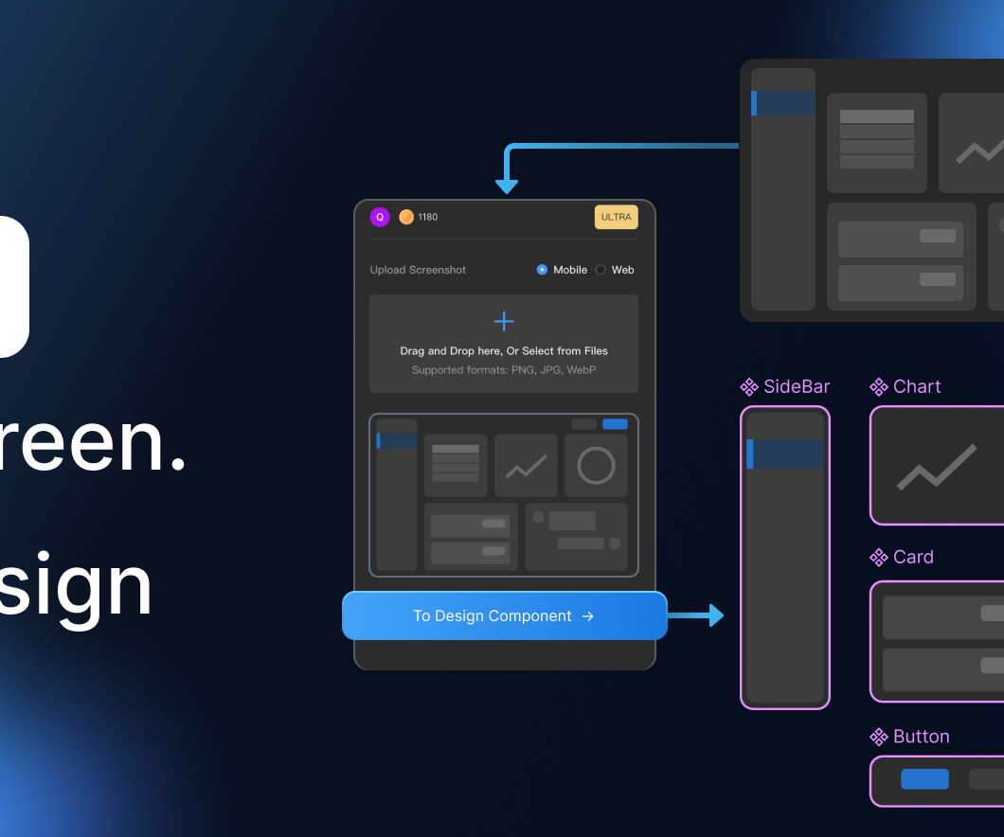
Figma Fundamentals
Figma Interface & Essential Tools
Interface Tour
Files: Your projects
Pages: Organize designs
Layers: All your elements
Assets: Reusable components
Essential Tools
Frames
Shapes
Artboards
Rect, circle
Text
Select
Type tool
Move/scale
Align
Group
Distribution
vs Frames
Pro Tip: Use Frames (not groups) for responsive design. Frames can have layouts, constraints, and auto-layout!

Slide 9
Figma Fundamentals
Layout, Styles & Assets
Layout Setup
Text Styles
Color Styles
Create reusable text styles for consistency:
Primary
1. Create a Frame
#4A5568
Press F → Select "Desktop" (1440×1024)
Heading
Accent
Desktop Frame
48px / Bold
#ED8936
Background
Subheading
#F8F5F2
24px / Medium
2. Add Grid
Click frame → Grid → Columns (12 cols, 80px width)
Body Text
Assets
16px / Regular
Find free icons & images:
Figma Community (plugins)
Select text → Click "Text" in right panel → + to create style
Unsplash (photos)
Phosphor Icons
Beginner Tip: Start with a frame, add a grid, create 2-3 text styles, and pick 3 colors. This gives you a solid foundation!

Slide 10
03
Build Your Landing Page
From Blank Canvas to Complete Design
Define
Wireframe
Design

Slide 11
Build Your Landing Page
The Design Process: Step by Step
1
Define Your Scenario
3
Build Mid-Fidelity UI
Choose what you're designing for:
Transform wireframes into polished design:
Online course landing page
Hero Section
Mobile app showcase
Local café website
• Add real headline & subheading
SaaS tool homepage
• Choose 1-2 brand colors
• Style CTA button (contrast, rounded)
Advanced: Create your own brief!
Features Section
2
Low-Fidelity Wireframe
• Three columns with icons
• Consistent spacing & alignment
Sketch with grey boxes & labels:
• Title + short description each
Hero Section
Testimonials
Feature 1
Feature 2
Feature 3
• Card layout with quote
• Name and role
Testimonial
CTA + Footer
• Strong, repeated CTA button
CTA Section
• Simple footer with links
Beginners: Follow step-by-step. Use provided style guide. Focus on completing each section.
Advanced: Use auto layout, create reusable components, experiment with refined spacing.

Slide 12
You're Ready to Design!
Structure
Figma
Practice
Landing pages follow a clear, proven structure that guides visitors
Your design playground with powerful tools to bring ideas to life
Every design makes you better. Keep experimenting and building!
Remember: Great designers aren't born—they're made through practice, curiosity, and persistence.
Enjoy the process
Stay curious
Keep creating

